Slide 1
AN OVERVIEW ON HEALTH CHECK PATTERNS

Slide 2



FAIL!

Slide 3


Slide 4

96%
99%
99%
CPU
RAM
99%
Network
99%
Disk

Slide 5

bugs
config issue
synchronization failed
memory leak
thread leak
pool misconfigurations
deadlocks

Slide 6
CPU
RAM
CPU
RAM
CPU
RAM
Network
Network
Network
Disk
Disk
Disk
CLIENT
SERVER
DB

Slide 7
88.5%
99%
99%
99%
99%
99%
99%
99%
99%
99%
99%
99%
99%
CLIENT
SERVER
DB

Slide 8
CPU
RAM
CPU
RAM
Network
Network
Disk
Disk
CLIENT
SERVER

Slide 9
CPU
RAM
Network
Disk
CPU
RAM
Network
CPU
RAM
Disk
Network
Disk
CPU
RAM
Network
CPU
RAM
Disk
Network
Disk

Slide 10

CPU
RAM
Network
Disk
CPU
RAM
Network
CPU
RAM
Disk
Network
Disk
CPU
RAM
Network
CPU
RAM
Disk
Network
Disk

Slide 11
HEALTH CHECK?

Slide 12
?
TELL? LIE?
CPU
RAM
!
Network
ACTION
Disk

Slide 13
!
ACTION
RESTART
TRAFFIC
SHAPING
DEPLOYMENTS
ALERTING
SCALING

Slide 14
TELL?
LIE?
N/A
SHALLOW
DEEP
PASSIVE

Slide 15
TELL?
LIE?
RETRIES
CIRCUIT
BREAKER
?
?
DEFAULTS
?
TIMEOUTS
FALLBACKS
Notes:
Retries?
- Not necessary, healtcheck can retry itself if you give it a lease period.
Fallbacks & Defaults?
- Deep healthcheck might ruin the effect of fallbacks
# Required patterns
Timeouts
- Either in application or at LB level

Slide 16
PATTERNS!

Slide 17
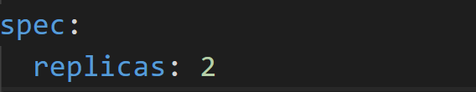
N/A
RESTARTS
Notes:
*Restart*
+ Based on existing requests / limits
*Traffic shaping*
N/A
*Alerting*
+ Based on the ratio of failed HTTP requests indirectly (passive)
+ Works for TCP as well!
- *DELAYING* if the rate drops because a dependent service timing out

Slide 18
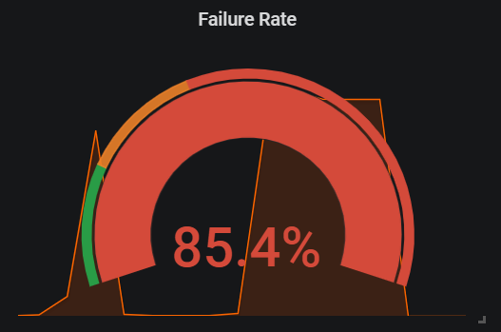
N/A
ALERTING
Notes:
*Restart*
+ Based on existing requests / limits
*Traffic shaping*
N/A
*Alerting*
+ Based on the ratio of failed HTTP requests indirectly (passive)
- Not working for TCP
- *DELAYING* if the rate drops because a dependent service timing out

Slide 19
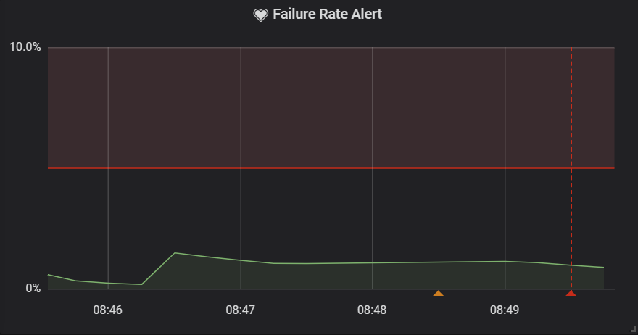
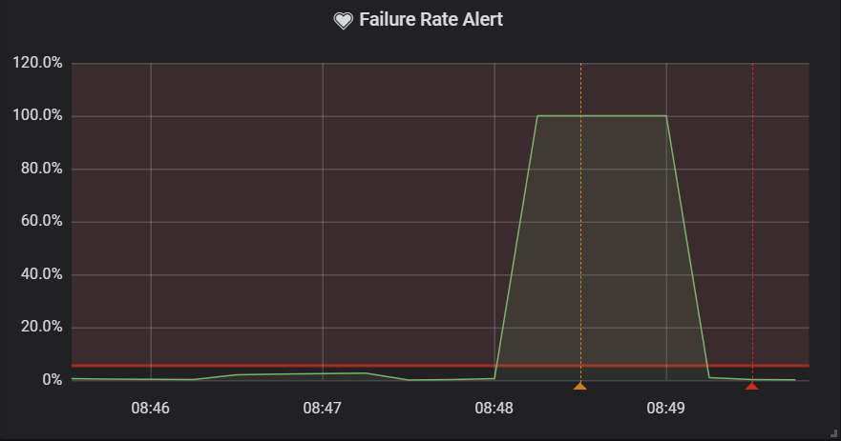
N/A
ALERTING
Interval = 5m
Interval = 1m
Notes:
*Restart*
+ Based on existing requests / limits
*Traffic shaping*
N/A
*Alerting*
+ Based on the ratio of failed HTTP requests indirectly (passive)
+ Works for TCP as well!
- *DELAYING* if the rate drops because a dependent service timing out

Slide 20
N/A
TRAFFIC SHAPING
DEPLOYMENTS
Notes:
*Restart*
+ Based on existing requests / limits
*Traffic shaping*
N/A
*Alerting*
+ Based on the ratio of failed HTTP requests indirectly (passive)
+ Works for TCP as well!
- *DELAYING* if the rate drops because a dependent service timing out

Slide 21
N/A
memory leak
thread leak
bugs
config issue
pool misconfigurations
deadlocks
Notes:
*Restart*
+ Based on existing requests / limits
*Traffic shaping*
N/A
*Alerting*
+ Based on the ratio of failed HTTP requests indirectly (passive)
+ Works for TCP as well!
- *DELAYING* if the rate drops because a dependent service timing out

Slide 22
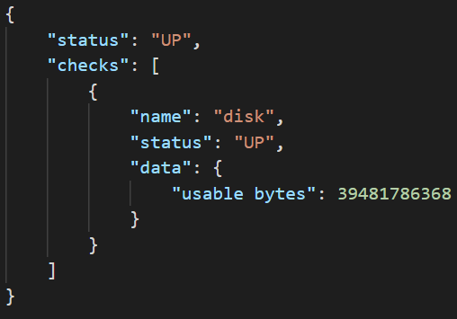
SHALLOW
Notes:
## Shallow healthcheck
*Restarts*
+ Helps if application has: memory, thread leak
- Won't help if dependent service becomes unavailable
- Won't help in case of deadlocks, pool misconfigs, bugs
*Traffic shaping*
+ Guarantees that only healthy services will recieve traffic
+ Reduces failure rate becasue of downtime
- Won't help if dependent services are not operational
*Alerting*
+ Based on reported health check status
- Not working if a dependent service is not operational
+ Based on the ratio of failed HTTP requests indirectly (passive)
- *DELAYING* if the rate drops because a dependent service timing out

Slide 23
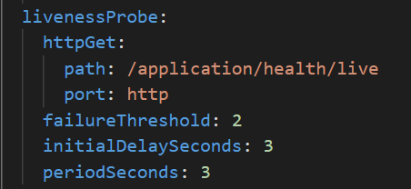
RESTARTS
SHALLOW
Notes:
## Shallow healthcheck
*Restarts*
+ Helps if application has: memory, thread leak
- Won't help if dependent service becomes unavailable
- Won't help in case of deadlocks, pool misconfigs, bugs
*Traffic shaping*
+ Guarantees that only healthy services will recieve traffic
+ Reduces failure rate becasue of downtime
- Won't help if dependent services are not operational
*Alerting*
+ Based on reported health check status
- Not working if a dependent service is not operational
+ Based on the ratio of failed HTTP requests indirectly (passive)
- *DELAYING* if the rate drops because a dependent service timing out

Slide 24



TRAFFIC SHAPING
SHALLOW
CPU
RAM
Network
Disk
Notes:
## Shallow healthcheck
*Restarts*
+ Helps if application has: memory, thread leak
- Won't help if dependent service becomes unavailable
- Won't help in case of deadlocks, pool misconfigs, bugs
*Traffic shaping*
+ Guarantees that only healthy services will recieve traffic
+ Reduces failure rate becasue of downtime
- Won't help if dependent services are not operational
*Alerting*
+ Based on reported health check status
- Not working if a dependent service is not operational
+ Based on the ratio of failed HTTP requests indirectly (passive)
- *DELAYING* if the rate drops because a dependent service timing out

Slide 25
POOL ISSUES
timeout
invalid connections
blocked threads
unbounded pool
overflooding
leaks
SHALLOW
Notes:
## Shallow healthcheck
*Restarts*
+ Helps if application has: memory, thread leak
- Won't help if dependent service becomes unavailable
- Won't help in case of deadlocks, pool misconfigs, bugs
*Traffic shaping*
+ Guarantees that only healthy services will recieve traffic
+ Reduces failure rate becasue of downtime
- Won't help if dependent services are not operational
*Alerting*
+ Based on reported health check status
- Not working if a dependent service is not operational
+ Based on the ratio of failed HTTP requests indirectly (passive)
- *DELAYING* if the rate drops because a dependent service timing out

Slide 26
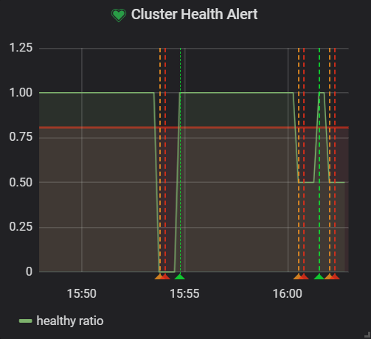
ALERTING
SHALLOW
Notes:
## Shallow healthcheck
*Restarts*
+ Helps if application has: memory, thread leak
- Won't help if dependent service becomes unavailable
- Won't help in case of deadlocks, pool misconfigs, bugs
*Traffic shaping*
+ Guarantees that only healthy services will recieve traffic
+ Reduces failure rate becasue of downtime
- Won't help if dependent services are not operational
*Alerting*
+ Based on reported health check status
- Not working if a dependent service is not operational
+ Based on the ratio of failed HTTP requests indirectly (passive)
- *DELAYING* if the rate drops because a dependent service timing out

Slide 27
SHALLOW
DEPLOYMENTS
Notes:
## Shallow healthcheck
*Restarts*
+ Helps if application has: memory, thread leak
- Won't help if dependent service becomes unavailable
- Won't help in case of deadlocks, pool misconfigs, bugs
*Traffic shaping*
+ Guarantees that only healthy services will recieve traffic
+ Reduces failure rate becasue of downtime
- Won't help if dependent services are not operational
*Alerting*
+ Based on reported health check status
- Not working if a dependent service is not operational
+ Based on the ratio of failed HTTP requests indirectly (passive)
- *DELAYING* if the rate drops because a dependent service timing out

Slide 28
memory leak
thread leak
SHALLOW
bugs
config issue
pool misconfigurations
deadlocks
Notes:
## Shallow healthcheck
*Restarts*
+ Helps if application has: memory, thread leak
- Won't help if dependent service becomes unavailable
- Won't help in case of deadlocks, pool misconfigs, bugs
*Traffic shaping*
+ Guarantees that only healthy services will recieve traffic
+ Reduces failure rate becasue of downtime
- Won't help if dependent services are not operational
*Alerting*
+ Based on reported health check status
- Not working if a dependent service is not operational
+ Based on the ratio of failed HTTP requests indirectly (passive)
- *DELAYING* if the rate drops because a dependent service timing out

Slide 29
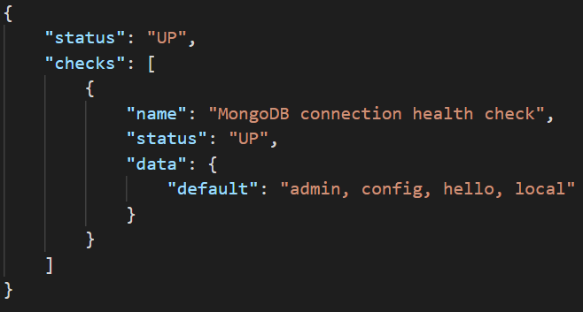
DEEP
Notes:
*Restart*
+ Helps if application has: memory, thread leak, pool misconfigurations
+ Might help if timeout pattern is not applied.
- Might help in case of deadlocks, if we probe the system with synthetic requests.
- You have to distinguish synthetic data from real usage statistics!
- To take maximum effect, we should monitor current service status and expose it
*Traffic shaping*
+ Removes pressure from services until they become healthy again
- _"If the DB server has become a single point of failure (SPOF) and has gone down, there may be an overreaction that can take all of the servers down, depending on how the back-end server check program is written."_
- Can ruin the effect of fallbacks and defaults
*Alerting*
+ Better understanding on higher level from application perspective
+ Overview on current state even if network partitioning occurs
*Deployment*
+ Startup probe can help avoiding misconfiguration and rollback to stable deployment.

Slide 30
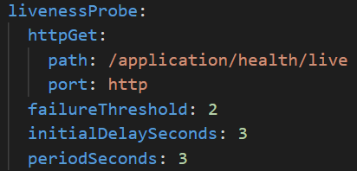
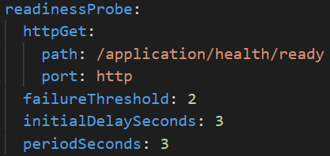
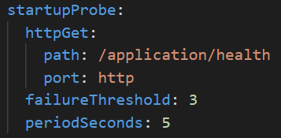
RESTARTS & DEPLOYMENTS
DEEP
Notes:
*Restart*
+ Helps if application has: memory, thread leak, pool misconfigurations
+ Might help if timeout pattern is not applied.
- Might help in case of deadlocks, if we probe the system with synthetic requests.
- You have to distinguish synthetic data from real usage statistics!
- To take maximum effect, we should monitor current service status and expose it
*Traffic shaping*
+ Removes pressure from services until they become healthy again
- _"If the DB server has become a single point of failure (SPOF) and has gone down, there may be an overreaction that can take all of the servers down, depending on how the back-end server check program is written."_
- Can ruin the effect of fallbacks and defaults
*Alerting*
+ Better understanding on higher level from application perspective
+ Overview on current state even if network partitioning occurs
*Deployment*
+ Startup probe can help avoiding misconfiguration and rollback to stable deployment.

Slide 31
FAIL OPEN
CPU
RAM
CPU
RAM
Network
Network
DEEP
Disk
Disk
Notes:
*Restart*
+ Helps if application has: memory, thread leak, pool misconfigurations
+ Might help if timeout pattern is not applied.
- Might help in case of deadlocks, if we probe the system with synthetic requests.
- You have to distinguish synthetic data from real usage statistics!
- To take maximum effect, we should monitor current service status and expose it
*Traffic shaping*
+ Removes pressure from services until they become healthy again
- _"If the DB server has become a single point of failure (SPOF) and has gone down, there may be an overreaction that can take all of the servers down, depending on how the back-end server check program is written."_
- Can ruin the effect of fallbacks and defaults
*Alerting*
+ Better understanding on higher level from application perspective
+ Overview on current state even if network partitioning occurs
*Deployment*
+ Startup probe can help avoiding misconfiguration and rollback to stable deployment.

Slide 32
TRAFFIC SHAPING
CPU
RAM
Network
Disk
?
fallbacks
defaults
DEEP
Notes:
*Restart*
+ Helps if application has: memory, thread leak, pool misconfigurations
+ Might help if timeout pattern is not applied.
- Might help in case of deadlocks, if we probe the system with synthetic requests.
- You have to distinguish synthetic data from real usage statistics!
- To take maximum effect, we should monitor current service status and expose it
*Traffic shaping*
+ Removes pressure from services until they become healthy again
- _"If the DB server has become a single point of failure (SPOF) and has gone down, there may be an overreaction that can take all of the servers down, depending on how the back-end server check program is written."_
- Can ruin the effect of fallbacks and defaults
*Alerting*
+ Better understanding on higher level from application perspective
+ Overview on current state even if network partitioning occurs
*Deployment*
+ Startup probe can help avoiding misconfiguration and rollback to stable deployment.

Slide 33
PROBING
CPU
RAM
Network
Disk
bugs
deadlocks
fallbacks
defaults
DEEP
Notes:
*Restart*
+ Helps if application has: memory, thread leak, pool misconfigurations
+ Might help if timeout pattern is not applied.
- Might help in case of deadlocks, if we probe the system with synthetic requests.
- You have to distinguish synthetic data from real usage statistics!
- To take maximum effect, we should monitor current service status and expose it
*Traffic shaping*
+ Removes pressure from services until they become healthy again
- _"If the DB server has become a single point of failure (SPOF) and has gone down, there may be an overreaction that can take all of the servers down, depending on how the back-end server check program is written."_
- Can ruin the effect of fallbacks and defaults
*Alerting*
+ Better understanding on higher level from application perspective
+ Overview on current state even if network partitioning occurs
*Deployment*
+ Startup probe can help avoiding misconfiguration and rollback to stable deployment.

Slide 34
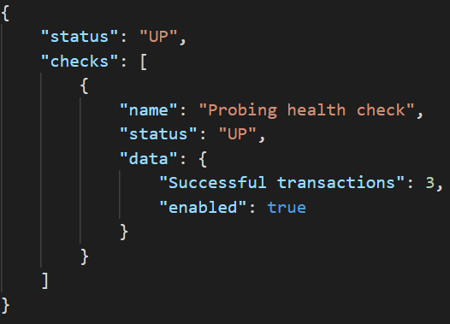
PROBING
DEEP
Notes:
*Restart*
+ Helps if application has: memory, thread leak, pool misconfigurations
+ Might help if timeout pattern is not applied.
- Might help in case of deadlocks, if we probe the system with synthetic requests.
- You have to distinguish synthetic data from real usage statistics!
- To take maximum effect, we should monitor current service status and expose it
*Traffic shaping*
+ Removes pressure from services until they become healthy again
- _"If the DB server has become a single point of failure (SPOF) and has gone down, there may be an overreaction that can take all of the servers down, depending on how the back-end server check program is written."_
- Can ruin the effect of fallbacks and defaults
*Alerting*
+ Better understanding on higher level from application perspective
+ Overview on current state even if network partitioning occurs
*Deployment*
+ Startup probe can help avoiding misconfiguration and rollback to stable deployment.

Slide 35
memory leak
thread leak
pool misconfigurations
bugs
config issue
deadlocks
DEEP
Notes:
*Restart*
+ Helps if application has: memory, thread leak, pool misconfigurations
+ Might help if timeout pattern is not applied.
- Might help in case of deadlocks, if we probe the system with synthetic requests.
- You have to distinguish synthetic data from real usage statistics!
- To take maximum effect, we should monitor current service status and expose it
*Traffic shaping*
+ Removes pressure from services until they become healthy again
- _"If the DB server has become a single point of failure (SPOF) and has gone down, there may be an overreaction that can take all of the servers down, depending on how the back-end server check program is written."_
- Can ruin the effect of fallbacks and defaults
*Alerting*
+ Better understanding on higher level from application perspective
+ Overview on current state even if network partitioning occurs
*Deployment*
+ Startup probe can help avoiding misconfiguration and rollback to stable deployment.

Slide 36
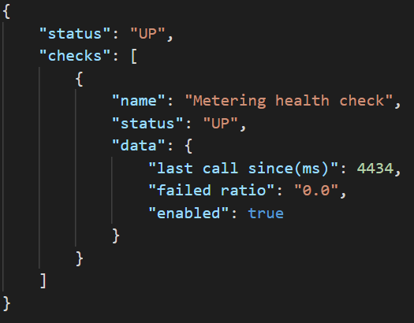
RESTARTS
PASSIVE
Notes:
## Passive healthcheck
*Restart*
+ To take maximum effect, we should monitor current service status and expose it
- Hard to nail it
*Traffic shaping*
+ Removes pressure from services until they become healthy again
+ Don't have to sync your configuration with fallbacks, defaults, circuit-breakers
*Alerting*
+ Better understanding on higher level from application perspective
+ Overview on current state even if network partitioning occurs

Slide 37
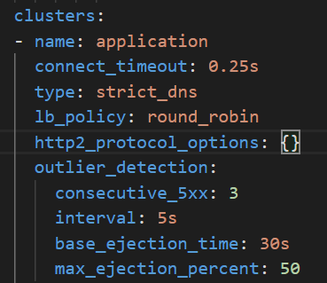
TRAFFIC SHAPING
PASSIVE
Notes:
## Passive healthcheck
*Restart*
+ To take maximum effect, we should monitor current service status and expose it
- Hard to nail it
*Traffic shaping*
+ Removes pressure from services until they become healthy again
+ Don't have to sync your configuration with fallbacks, defaults, circuit-breakers
*Alerting*
+ Better understanding on higher level from application perspective
+ Overview on current state even if network partitioning occurs

Slide 38
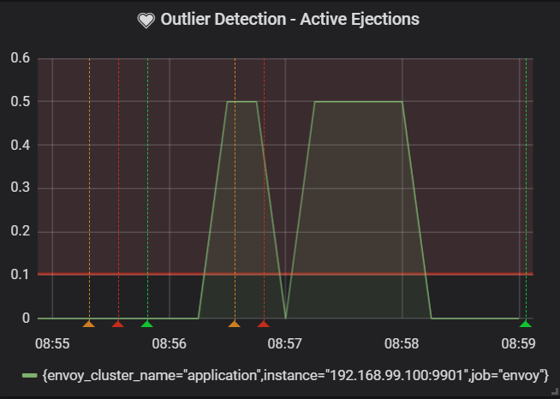
ALERTING
PASSIVE
Notes:
## Passive healthcheck
*Restart*
+ To take maximum effect, we should monitor current service status and expose it
- Hard to nail it
*Traffic shaping*
+ Removes pressure from services until they become healthy again
+ Don't have to sync your configuration with fallbacks, defaults, circuit-breakers
*Alerting*
+ Better understanding on higher level from application perspective
+ Overview on current state even if network partitioning occurs

Slide 39
memory leak
thread leak
pool misconfigurations
bugs
config issue
deadlocks
PASSIVE
Notes:
## Passive healthcheck
*Restart*
+ To take maximum effect, we should monitor current service status and expose it
- Hard to nail it
*Traffic shaping*
+ Removes pressure from services until they become healthy again
+ Don't have to sync your configuration with fallbacks, defaults, circuit-breakers
*Alerting*
+ Better understanding on higher level from application perspective
+ Overview on current state even if network partitioning occurs

Slide 40
DEMO!

Slide 41




Envoy
CPU
RAM
Network
Disk

Slide 42


Slide 43

AN OVERVIEW ON HEALTH CHECK PATTERNS

